Slide 1
Week 8 Notes
PHY495: Hoop Never Misses

Slide 2
What I’ve Done
Wrote a function that randomly chooses, for n points on the backboard, y values within some range with evenly distributed x values
For the random backboard coordinates, the function looks at which results in a greater percent of random shots in – this is the optimal three point backboard
In the process of hard coding some initial conditions to see whether the three points is truly working → I realized I had to change the way I wrote my hit_backboard function

Slide 3
What Worked
Made a 3 point backboard
Runs as expected

Slide 4
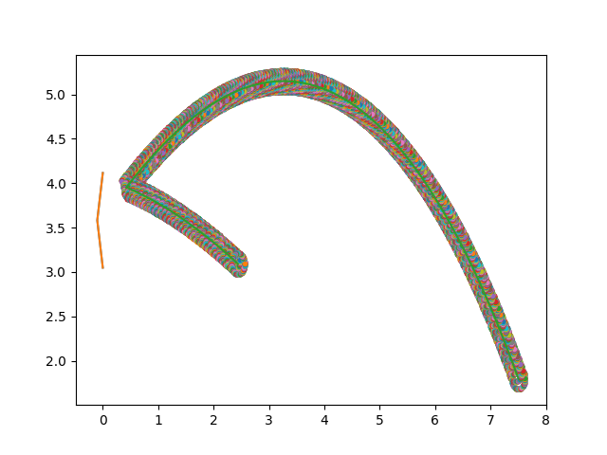
What Didn’t Work
For this initial condition that I chose, it registers that it doesn’t hit the backboard but doesn’t go within the correct range of the backboard before it rebounds – I can’t figure out where in the code the error is that makes it rebound too early

Slide 5
What Next?
Extend the three points backboard to running with more initial conditions, random initial conditions then start looking at running it with more points on the backboard

